Slide 1
Smart Contracts
Neerajsing Rajput

Slide 2
Topics
Problem
Challenges
Process
Architecture
Results

Slide 3
Problem
To identify the real Credit Agreements from the given list of URLs
If you find out about the real credit agreements what is the next step.
The documents have to be indexed if you find out the real credit agreements.

Slide 4
Challenges and Solution
There is no normal process to find out the Credit Agreement.
So let the documents be indexed and if it indexes then that means it is a Credit Agreement.
This approach helped to found out 113 out of 700 urls.
These documents were indexed as per the approach discussed i.e. separating the table of content and the content itself.
Then finding all the sections and store it in Section List.

Slide 5
Input and Output
Input: List of urls
Output: Indexed JSON files of Contract
1 contract will have 1 JSON File.
The folder will contain list of several JSON file.

Slide 6
SCHEMA
{
headers:"Contain information about the borrowers,lendors and guarantors with signification Dates",
title:"Title of Document",
tableOfContent:"Has Table of Contents",
sectionList:[{
sectionNumber:"",
sectionContent:""
}],
definedTermList:[{
term:"",
definition:""
}]
}

Slide 7

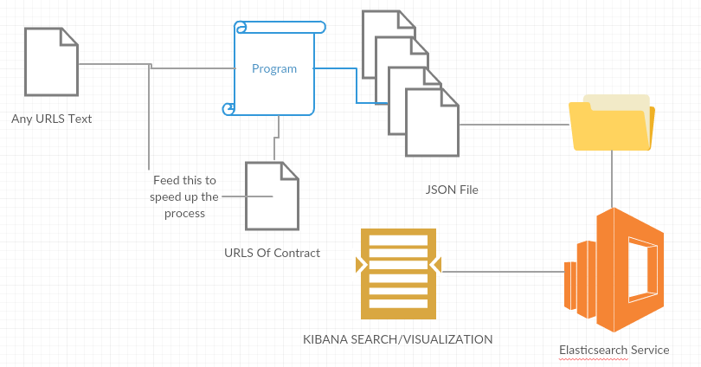
Architecture
Program iterates over the URLs text file and create JSON files and Urls of contract.
All the JSON files are put to ElasticSearch and it is searched using Kibana

Slide 8
Steps To Process the URLS
Make sure when you run the Program the Elasticsearch server is up and running.
Please provide the correct input path for the URLS
Provide the correct folder for saving all the JSON file.
Check the localhost at port 9200 and put the contract indexes.
Start the Kibana Server and go to localhost port 5601.
Insert the index which you put in the Elastic search.
The contracts will be automatically visualized

Slide 9
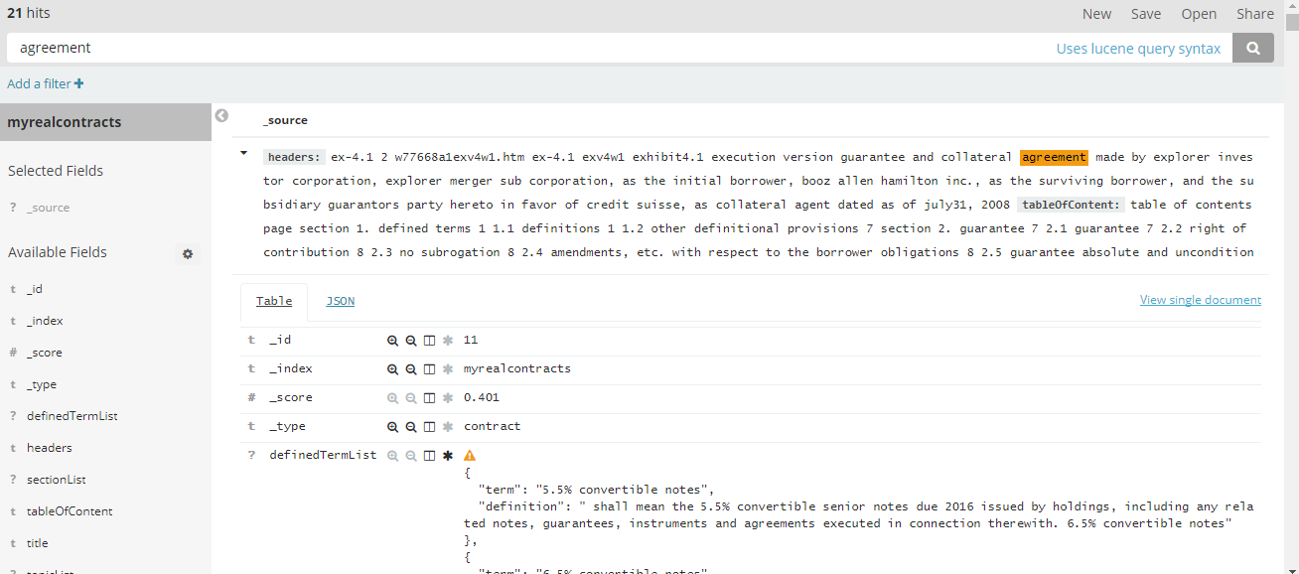
Results

Slide 10
Helper
11 Contracts
1. finalsimplecontracts- JSON without topicList
2. finalcontracts- JSON with topicList
100 Contracts
Hunderedfinalcontracts-JSON with topicList
hunderedfinalsimplecontracts-JSON without topicList

